Slide 1
Skew Management of NBTI Impacted Gated Clock Trees
International Symposium on Physical Design 2010
Ashutosh Chakraborty and David Z. Pan
ECE Department, University of Texas at Austin
ashutosh@cerc.utexas.edu dpan@cerc.utexas.edu
Notes:
Good evening everyone. My name is Ashutosh Chakraborty and I am doing my PhD at University of Texas at Austin. The topic of my paper in ISPD and this presentation is “Skew Management of NBTI Impacted Gated Clock Trees”. This work was done by me and my PhD advisor Prof. David Pan.

Slide 2
Outline
Background: Clock Gating & NBTI Effect
Problem: Skew due to NBTI in gated clock
Previous Works
Proposed Solution
Results
Notes:
Here is the outline of my talk. First of all, I will provide relevant background of NBTI effect and clock gating technique which would set the stage for description of the problem solved in this work. The previous works that have tackled this issue will be discussed next. Our proposed solution and the results obtained would then be presented.

Slide 3
Clock Gating
Very popular low power technique
Freeze (“gate”) clock to inactive module
Needs: Signal informing if a module is inactive
Needs: Way to use this signal to freeze clock
Inactivity deduced by checking input permutations
Example: OPCODE for adder? Freeze multiplier clock
RTL simulation and ON/OFF set manipulation helps
Notes:
Now a few quick points about clock gating. Clock gating is a very popular technique to reduce dynamic power consumption of a circuit. Clock gating works by freezing the clock signal of a subpart of the circuit causing all the switching activities at registers output and combinational gates to freeze. For example, if the multiplier in this circuit is not used we can freeze the clock going into.

Slide 4
Clock Gating (2)
Duration of gating determined by many factors
Gating aggressiveness, input data statistics
How to stop clock signal?
Use NAND/NOR/AND/OR gate
One input: regular clock signal
Other input: Inactivity/Activity signal
CLK
CLK_OUT
Active?
Notes:
Now a few quick points about clock gating. Clock gating is a very popular technique to reduce dynamic power consumption of a circuit. Clock gating works by freezing the clock signal of a subpart of the circuit causing all the switching activities at registers output and combinational gates to freeze. For example, if the multiplier in this circuit is not used we can freeze the clock going into.

Slide 5
Example Clock Tree
FLOPS
CLK

Slide 6
Minimize Clock Gating Elements
FLOPS
40%
CLK
20%
30%

Slide 7
Implementation using NANDs
FLOPS
GATE: 40%
CLK
GATE: 20%
GATE: 30%

Slide 8
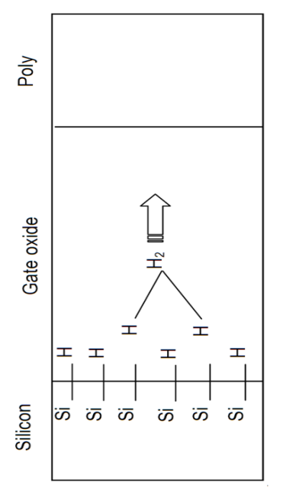
NBTI Effect
Negative Bias Temperature Instability
Occurs when PMOS negatively biased (V_{GS}<0)
Reason:
V_{GS}<0 causes Si-H breaking
Need higher V_{G} to invert channel
Effects:
∆V_{TH} = +100mV 10 years
30% increase in inverter delay
POLY
OXIDE
S
D
[Kumar et. al. DAC 2007]
[Alam et. al. 2005
Micro. Reliab.]
Notes:
NBTI stands for Negative Bias Temperature Instability. “Negative Bias” refers to the fact that NBTI happens when the PMOS device is negatively biased. NBTI is caused by rupture of Si-H bond at channel and oxide interface leaving positively charged Si ions at interface. The effect of NBTI is that now to invert the channel, we need to apply higher gate voltage which essentially means the threshold voltage has increased. We can expect the Vth to increase by around 50mV after 10 years of aging.

Slide 9
NBTI Effect (2)
Proportional to negative bias duration (~t^{N})
For PMOS in standard cells,
V_{GS} < 0 ➔ V_{G} < V_{DD} ➔ Input to cell = logic LOW
Thus, logic LOW feeding a cell causes NBTI
Differing LOW probability ➔ different degradation
Define SP0 = Probability of signal to be LOW
Higher SP0 ➔ More NBTI Degradation
Notes:
The degradation due to NBTI is proportional to the duration of time the PMOS is under negative Vgs. Let us denote the fraction of time Vgs is negative as Signal Probability (SP). Larger is the SP of a net, higher is the Vth degradation of the PMOS driven by it. For example, here are two waveforms with 80% and 20% SP.

Slide 10
Outline
Background: NBTI & Clock Gating
Problem: Skew due to NBTI in gated clock
Previous Works
Proposed Solution
Results
Notes:
Let us now see how NBTI effect in clock gating causes skew degradation.

Slide 11
SP0 Difference due to Clock Gating
SP0=50%
SP0=50%
CLK
Larger ∆V_{TH}
Skew?
SP0=50%
SP0=50%
SP0=35%
GATE: 30%
Lower ∆V_{TH}
Using NAND gate reduces SP0 at output
Using NOR gate increases SP0 at output
In both cases, ∆V_{TH} mismatch will exist!
11

Slide 12
Problems due to ∆V_{TH} mismatch?
Clock skew can degrade significantly!
Up to 2.5X increase in skew [Chakraborty et al, DATE 2009]
Large variation due to difference in nominal values
Will lead to timing violation and circuit failure

Slide 13
Outline
Background of NBTI & Clock Gating
Problem: Skew due to NBTI in gated clock
Previous Works
Proposed Solution
Results

Slide 14
Previous Works
2003: US patent 6651230 [John Cohn et. al.]
Essentially overdesign by tightening skew bound.
A limit to which skew constraint can be tightened.
2009: DATE 09 [Chakraborty et. al.]
First runtime compensation for NBTI in clock trees
At runtime, choose NAND or NOR to drive
Aims to equalize all signal probabilities (of clock nets)
Power Penalty? Routing?

Slide 15
Previous Works (2)
CLK
NOR
Gated at 0
MUX
GATE
CLK_OUT
NAND
CLK
Gated at 1
SELECT
If { GATE = FALSE } CLK_OUT = CLK
Else If { SELECT = 0 } CLK_OUT = 0
Else CLK_OUT = 1

Slide 16
Outline
Background of NBTI & Clock Gating
Problem: Skew due to NBTI in gated clock
Previous Works
Proposed Solution
Results

Slide 17
Main Idea
NAND Gate increases SP0 at output
NOR Gate reduces SP0 at output
SP0 impacts delay cell of the cell being driven
Need to reduce delay difference at sinks
Multiple levels of clock gating elements
Can we selectively choose NAND/NOR at the right places, so that even if SP0 is different within the tree, by the time sinks are reached, the delay difference is minimized?

Slide 18
Proposed Solution
At design time (i.e. statically), determine NAND or NOR choice for each gating enabled buffer
Objective: Minimize skew after NBTI aging
Benefits:
No hardware penalty w.r.t. regular clock gating
No glitches due to SELECT signal switch
No extra routing overhead

Slide 19
Our Optimization Flow
Symbolic SP0
Propagation
SP0 Aware Delay
Characterization
Symbolic Arrival
Time Computation
Skew Minimization Formulation
Solve

Slide 20
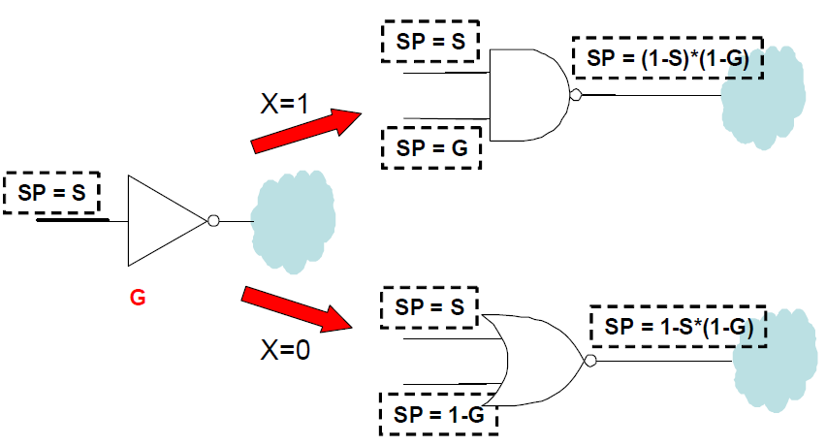
Propagate SP0 in Clock Tree
For gating probability of G & input SP0 of S, output SP0 for NAND or NOR choice:

Slide 21
Example: SP0 Propagation

Slide 22
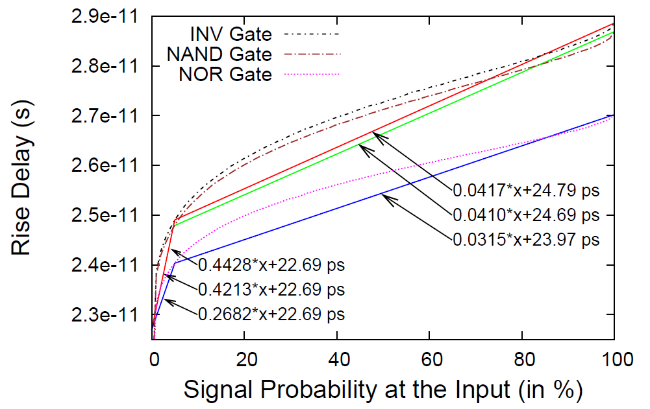
Delay Characterization
NBTI impacts TRISE. TFALL unchanged
TRISE characterization w.r.t. SP needed
Conducted SPICE simulations to obtain
Rise Delay
Input SP0

Slide 23
Example [Delay Expression]
DINV(0.5) +
X2 * DNAND(0.5) + X2’ * DNOR(0.5) +
( X4 * DNAND( 0.72 - X2 * 0.5 ) + X4’ * DNOR( 0.75 - X2 * 0.5 ) )

Slide 24
Can the expressions of Delay and SP become unmanageable as we traverse down the clock tree?
Like: X1*X2*X3’*X4*X6’…

Slide 25
Observations
Lemma 1: SP0 of any gate is at most a linear function of Xi.
No multiplication of Xi in SP expression.
Lemma 2: Delay expression is at most a quadratic function of Xi
X1*X2 possible. Not X1*X2*X3 etc.
Thus, delay/SP0 expression remain only quadratic functions of Xi.
If Xi binary, quadratic => linear transformation

Slide 26
ILP Formulation
Minimize: MAX – MIN // Both dummy variables
Subject To:
Arrival Time(Sink i) <= MAX for all i;
Arrival Time(Sink i) >= MIN for all i;
MAX >= 0;
MIN >= 0;
Xi = {0, 1}
Max
Min

Slide 27
Experimental Setup
Generated balanced clock trees (skew=0)
9K to 350K sinks.
Buffers at all branching points
Picked 2% of buffers as gating enabled
Assign 20% ⬄ 70% gating probability
Clock source input SP=0.5
Spice netlist from 45nm Nangate library
C++ for SP propagation & ILP writing
Mathematica to reduce. CPLEX to solve.

Slide 28
Benchmarks
Name | Depth | Fanout | # Buffers | # Sinks | # Gated
A | 7 | 4 | 22k | 87k | 331
B | 8 | 3 | 10k | 8k | 144
C | 9 | 3 | 29k | 26k | 426
D | 8 | 4 | 88k | 349k | 1251
E | 9 | 3 | 29k | 26k | 430
F | 8 | 3 | 10k | 9k | 138
G | 8 | 4 | 87k | 349k | 1267
H | 7 | 4 | 22k | 87k | 326

Slide 29
Outline
Background of NBTI & Clock Gating
Problem: Skew due to NBTI in gated clock
Previous Works
Proposed Solutions
Results

Slide 30
Results
Age the circuit to 10 years
Calculated skew for four cases
Choose NAND/NOR based on our formulation
Choosing all NAND gates
Choosing all NOR gates
Try 10 random assignment, pick best

Slide 31
Results (contd)
Name | Solver Time (s) | OUR Skew (ps) | All NAND (ps) | All NOR (ps) | 10 Rand. (ps)
A | 0.14 | 2.80 | 4.41 | 9.02 | 7.24
B | 0.06 | 2.18 | 3.23 | 5.84 | 4.96
C | 1.41 | 4.13 | 6.4 | 9.28 | 7.05
D | 0.81 | 3.03 | 5.04 | 9.74 | 6.21
E | 0.12 | 2.76 | 5.46 | 10.21 | 7.04
F | 0.09 | 3.94 | 6.21 | 12.23 | 11.82
G | 0.47 | 3.88 | 6.75 | 13.07 | 10.58
H | 0.09 | 2.59 | 3.91 | 8.44 | 5.38
Avg: |  | 1 | 1.56X | 2.19X | 1.33X
Our > Rand > NAND > NOR solution
Significantly tightens the skew budget

Slide 32
Conclusions
Proposed choosing NAND/NOR gating at design time minimize skew degradation.
Optimal (ILP) results show 55% and 120% lower skew than all NAND/all NOR cases.
Random + pick best results reduce 20% and 80% over all NAND/all NOR cases.
Fast. Log(n) binary variables.
Future Works:
ILP is NP complete. Some other formulation.
How ICGs can be handled.

Slide 33
Thank you.
Questions?

